Slide 1
An Alternative Approach to Alignments
Vineet Joshi, Prateek Tandon, Frank Lin

Slide 2
Project Goal
To find an alternative, more efficient method to deal with patterns containing long regions of deletions.

Slide 3
Problems Solved
Matching cDNA to its genomic loci (matching exons to genomic loci while ignoring introns).
Detecting sequence deletions in a mutated gene, when compared to a reference genome.

Slide 4
Motivation
In this course, we covered exact pattern matching using suffix trees.
We wanted to expand upon what we learned and apply our knowledge to a more biological problem.
Ukkonen’s paper “Approximate String-Matching Over Suffix Trees”.
Try to use suffix trees to solve this problem.

Slide 5
Motivation
Current methods, using dynamic programming and affine gap penalties, require O(mn) time.
We wanted to find a method that has a better average time complexity.
We wanted to look for a method that doesn’t penalize the gaps occurring in the intron regions.
To better estimate of the overall alignments.

Slide 6
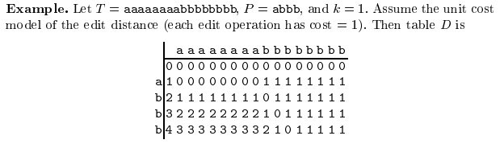
Motivation
The simple dynamic programming solution for alignments has the drawback that it is explicitly repeated over identical repeated substrings of T.

Slide 7
Approach
We used a combination of theories from:
K-difference problem
Suffix trees (with suffix links)
Dynamic programming
Ukkonen's algorithm for K differences

Slide 8
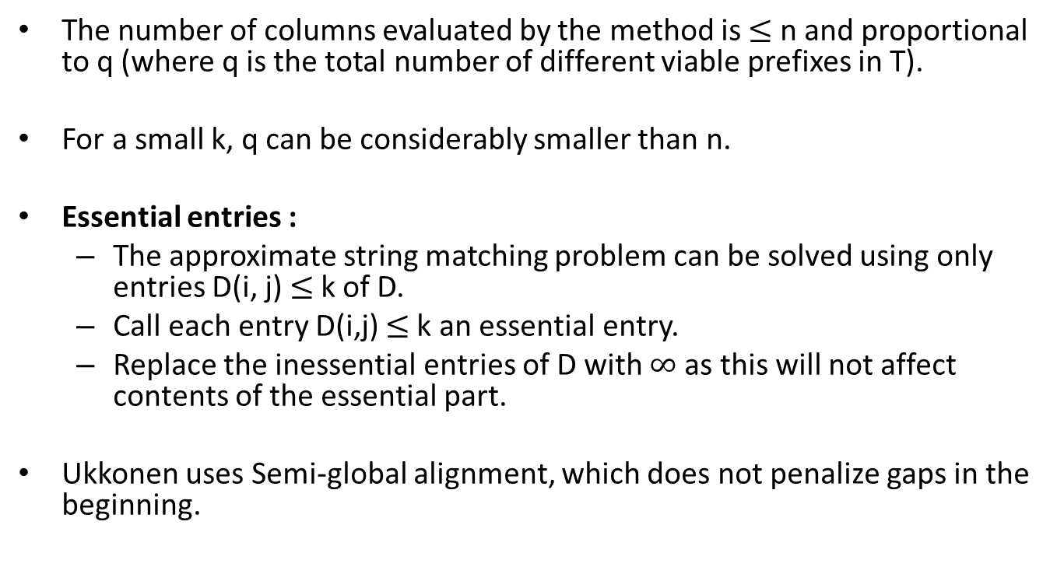
Overview of Ukkonen’s Algorithm
The number of columns evaluated by the method is $≤$ n and proportional to q (where q is the total number of different viable prefixes in T).
For a small k, q can be considerably smaller than n.
Essential entries :
The approximate string matching problem can be solved using only entries D(i, j) $≤$k of D.
Call each entry D(i,j) $≤$k an essential entry.
Replace the inessential entries of D with $∞$ as this will not affect contents of the essential part.
Ukkonen uses Semi-global alignment, which does not penalize gaps in the beginning.

Slide 9
Our Implementation
We start filling in the columns starting with t₁, using the Ukkonen method involving suffix tree for T, only evaluating for columns that have a unique Q.
We allow for k-mismatches in the regions that overlap between cDNA and gene.
We will extend the matching beyond a certain threshold length “L” that is long enough to ensure that the current matches are not occurring by chance alone.

Slide 10
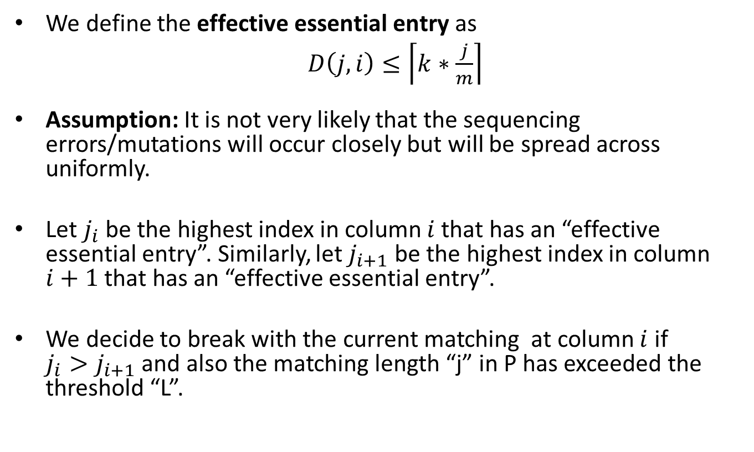
A Greedy Approach
We define the effective essential entry as
$D\left(j,i\right)≤\left\lceil \left.k∗\frac{j}{m}\right\rceil \right.$
Assumption: It is not very likely that the sequencing errors/mutations will occur closely but will be spread across uniformly.
Let $j_{i}$ be the highest index in column $i$that has an “effective essential entry”. Similarly, let $j_{i+1}$ be the highest index in column $i+1$ that has an “effective essential entry”.
We decide to break with the current matching at column $i$ if $j_{i}>j_{i+1}$ and also the matching length “j” in P has exceeded the threshold “L”.

Slide 11
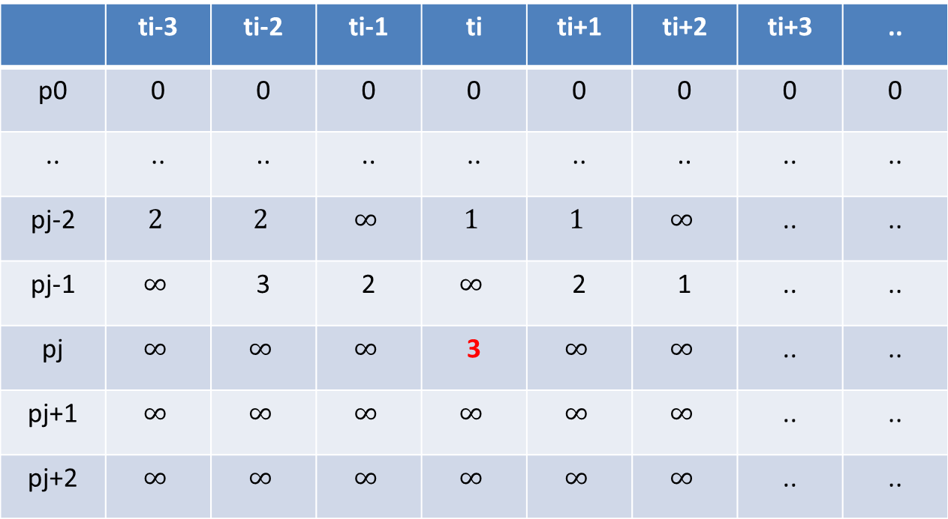
 | ti-3 | ti-2 | ti-1 | ti | ti+1 | ti+2 | ti+3 | ..
p0 | 0 | 0 | 0 | 0 | 0 | 0 | 0 | 0
.. | .. | .. | .. | .. | .. | .. | .. | ..
pj-2 | $$2$$ | $$2$$ | $$∞$$ | $$1$$ | $$1$$ | $$∞$$ | .. | ..
pj-1 | $$∞$$ | 3 | 2 | $$∞$$ | 2 | 1 | .. | ..
pj | $$∞$$ | $$∞$$ | $$∞$$ | 3 | $$∞$$ | $$∞$$ | .. | ..
pj+1 | $$∞$$ | $$∞$$ | $$∞$$ | $$∞$$ | $$∞$$ | $$∞$$ | .. | ..
pj+2 | $$∞$$ | $$∞$$ | $$∞$$ | $$∞$$ | $$∞$$ | $$∞$$ | .. | ..
Also, j >= ’L’

Slide 12
A Greedy Approach
We continue matching the remaining P with the remaining T and we will now have shorter columns in our table.
So this problem becomes an equivalent problem with k’ mismatches between text T’ = t_{i+1}, t_{i+2}, …, t_{n} and pattern P’ = p_{j+1}, p_{j+2}, …, p_{m}
In general, after processing the s^{th} exon, we check if the node_length = (m-j_{s-1}) then we copy to the edit distance matrix, else we compute it and store it.
This can be done relatively easily since we already keep track of the indices at the leaves in Suffix tree (T).

Slide 13


Example
SuffixTree(T)
$$≥L$$
$$≥L$$
$$≥L$$
t1
t2
tx
tn

Slide 14


SuffixTree(T)
ti
pj
t1
ti
t2
tx
tn
t i+1
SuffixTree(T)
p j+1
$$≥L$$
$$≥L$$
t i+1
tx
tn

Slide 15
A Greedy Approach
We stop if all of pattern P is matched to some location in T and report all such matches.
Otherwise, we report all the partial matches if P doesn’t match completely by the time we go over the entire text T.

Slide 16
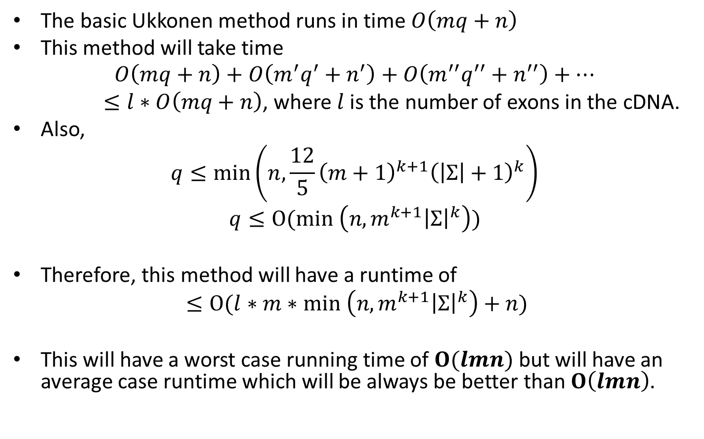
Runtime Analysis
The basic Ukkonen method runs in time $O\left(mq+n\right)$
This method will take time
$$O\left(mq+n\right)+O\left(m^{′}q^{′}+n^{′}\right)+O\left(m^{′′}q^{′′}+n^{′′}\right)+…$$
$≤l∗O\left(mq+n\right)$, where $l$is the number of exons in the cDNA.
Also,
$$q≤\min\left(n,\frac{12}{5}{\left(m+1\right)}^{k+1}{\left(\left|Σ\right|+1\right)}^{k}\right)$$
$$q≤O(min \left(n,m^{k+1}{\left|Σ\right|}^{k}\right))$$
Therefore, this method will have a runtime of
$$≤O(l∗m∗min \left(n,m^{k+1}{\left|Σ\right|}^{k}\right)+n)$$
This will have a worst case running time of $O(lmn)$ but will have an average case runtime which will be always be better than $O\left(lmn\right).$

Slide 17
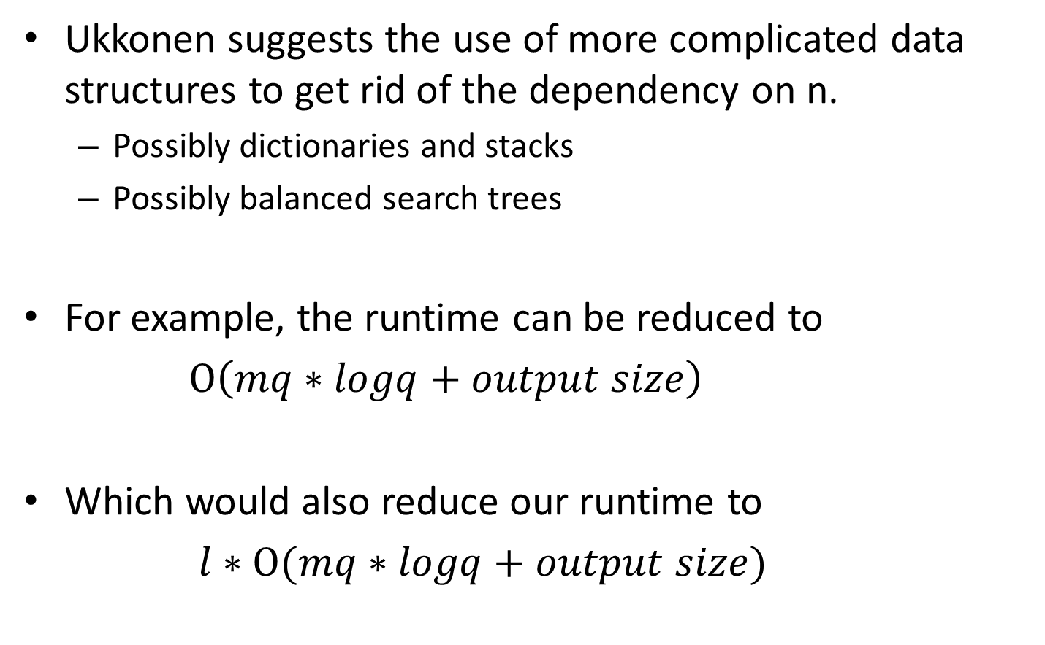
Further Runtime Improvements
Ukkonen suggests the use of more complicated data structures to get rid of the dependency on n.
Possibly dictionaries and stacks
Possibly balanced search trees
For example, the runtime can be reduced to
$O\left(mq∗logq+output size\right)$
Which would also reduce our runtime to
$l∗O(mq∗logq+output size)$

Slide 18
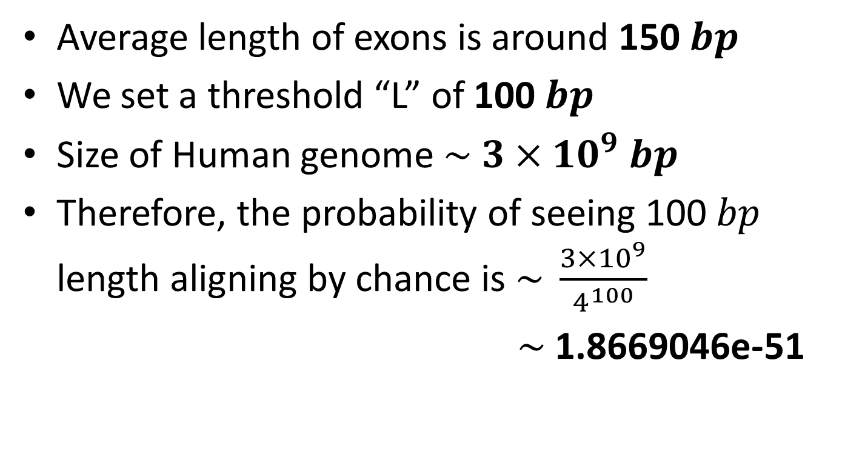
Plausible?
Average length of exons is around 150 $bp$
We set a threshold “L” of 100$bp$
Size of Human genome $\sim 3×{10}^{9} bp$
Therefore, the probability of seeing 100$bp$ length aligning by chance is $\sim \frac{{3×10}^{9}}{4^{100}}$
$\sim$1.8669046e-51

Slide 19
Plausible?
On average, there are 8.8 exons and 7.8 introns per gene
In Silico Biol. 2004;4(4):387-93.
Distributions of exons and introns in the human genome.
Sakharkar MK, Chow VT, Kangueane P.
Average intron length is > 1 kb and
Average exon length is only 150 bp
http://people.ibest.uidaho.edu/~bree/courses/17_EBR_ME_genome.pdf

Slide 20
Pros and Cons of Our Implementation
Pros
Average time complexity < O(mn)
Overall less space required
Can align cDNA to genomic loci
Cons
Current implementation can not give multiple matches (only first best match)
Might not be efficient for very small exon lengths
Possibly change “L”
Further improvements needed

Slide 21
Questions?

Slide 22
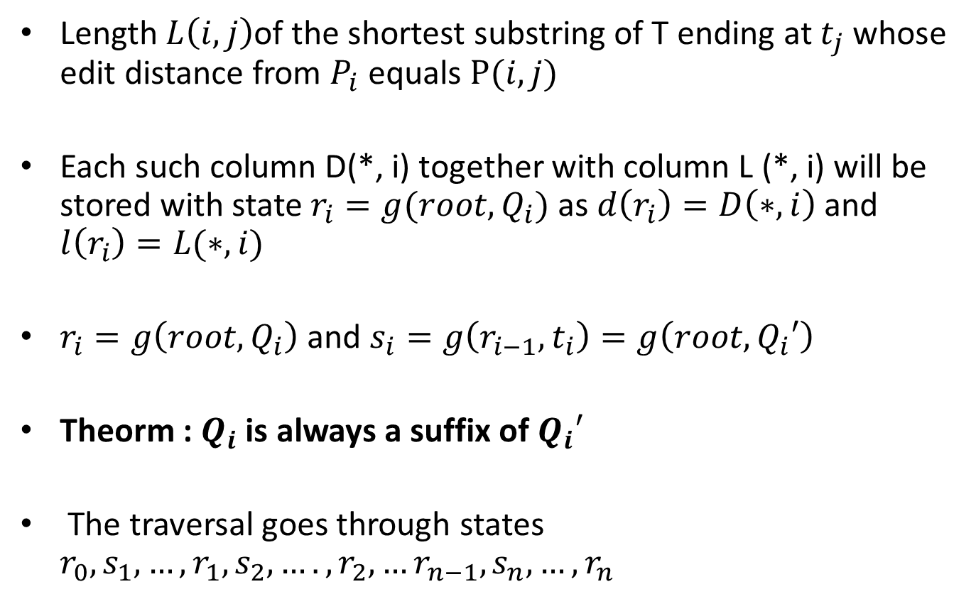
More On Ukkonen’s Algorithm
Length $L\left(i,j\right)$of the shortest substring of T ending at $t_{j}$ whose edit distance from $P_{i}$ equals $P(i,j)$
Each such column D(*, i) together with column L (*, i) will be stored with state $r_{i}=g(root,Q_{i})$ as $d\left(r_{i}\right)=D\left(∗,i\right)$ and $l\left(r_{i}\right)=L(∗,i)$
$r_{i}=g\left(root,Q_{i}\right)$ and $s_{i}=g\left(r_{i−1},t_{i}\right)=g\left(root,Q_{i}′\right)$
Theorm : $Q_{i}$ is always a suffix of $Q_{i}′$
The traversal goes through states $r_{0}, s_{1},…,r_{1},s_{2},….,r_{2},…r_{n−1}, s_{n}, …, r_{n}$

Slide 23
More On Ukkonen’s Algorithm
Qi’
Qi
Qi -1
ri
ri-1
ti
si

Slide 24
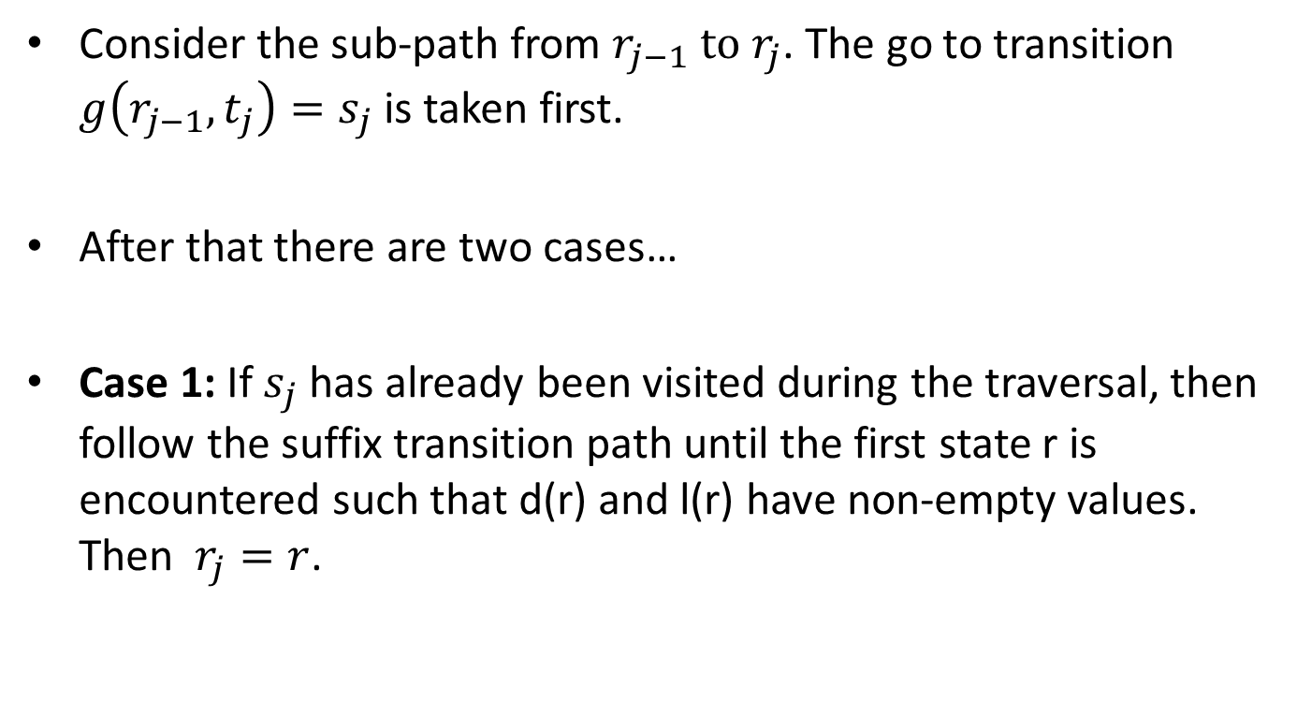
More On Ukkonen’s Algorithm
Consider the sub-path from $r_{j−1} to r_{j}$. The go to transition $g\left(r_{j−1},t_{j}\right)=s_{j}$ is taken first.
After that there are two cases…
Case 1: If $s_{j}$ has already been visited during the traversal, then follow the suffix transition path until the first state r is encountered such that d(r) and l(r) have non-empty values. Then $r_{j}=r$.

Slide 25
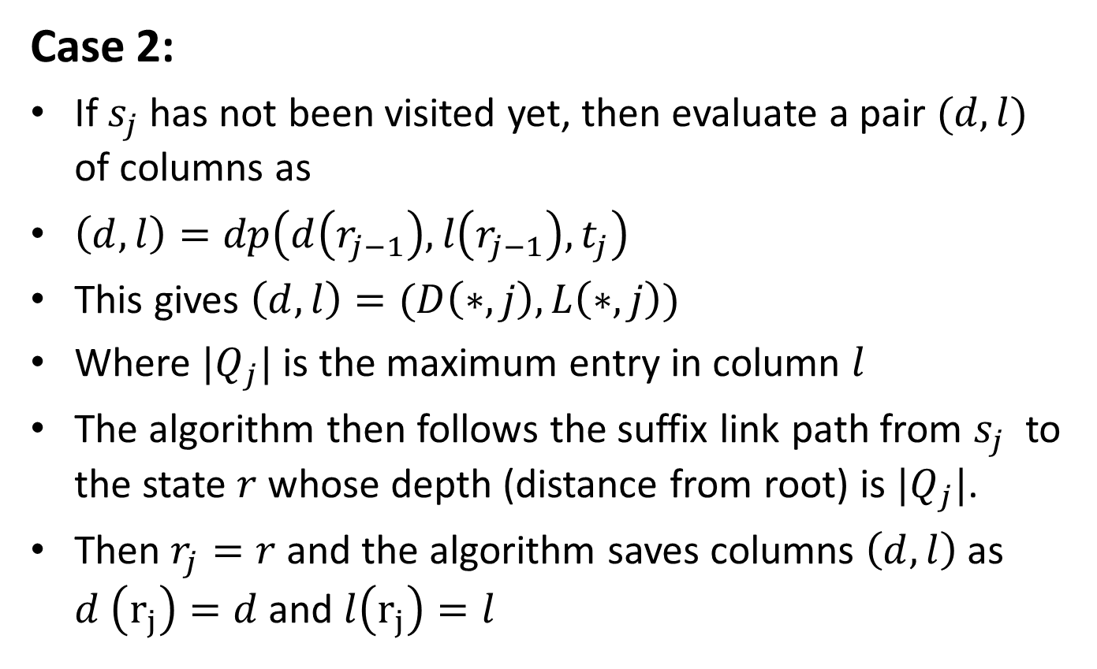
More On Ukkonen’s Algorithm
Case 2:
If $s_{j}$ has not been visited yet, then evaluate a pair $(d,l)$ of columns as
$\left(d,l\right)=dp\left(d\left(r_{j−1}\right),l\left(r_{j−1}\right),t_{j}\right)$
This gives $\left(d,l\right)=(D\left(∗,j\right),L\left(∗,j\right))$
Where $|Q_{j}|$ is the maximum entry in column $l$
The algorithm then follows the suffix link path from $s_{j}$ to the state $r$ whose depth (distance from root) is $|Q_{j}|$.
Then $r_{j}=r$and the algorithm saves columns $\left(d,l\right)$as $d \left(r_{j}\right)=d$ and $l\left(r_{j}\right)=l$

